Slide 1



Dining Management System of Khulna University
Sumaiah Binta Musa || Istyaque Ahammed || Samundra Dhakal 190205 || 200240 || 200245

Slide 2


Introduction
Database system for converting dining hall meal receipt and payment process from manual to online. Students can pre-order lunch and dinner with pre-payment facility using the system. Easy order management facility using database for dining managers and users.

Slide 3
Hall Of Khulna University
01
Jatir Janak Bangabandhu Sheikh Mujibur Rahman Hall
02
Khan Jahan Ali Hall
Khan Bahadur Ahasanullah Hall
03
04
Aparajita Hall
05
Bongomata Begum Fazilattunesa Mujib Hall

Slide 4
What is motivation for this project?

Slide 5
Interesting queries:
In our system there can be two types of query. One is from manager side and another is from user side.
Manager queries:
Total amount of meals per day.
Total amount of money per day.
List of students of taking every day meal.
Which students take highest meal per month?
In which day of week highest number of students take meal.
User queries:
How much money he/she spend for meal per month.
How many days he/she takes meal in a particular month.

Slide 6
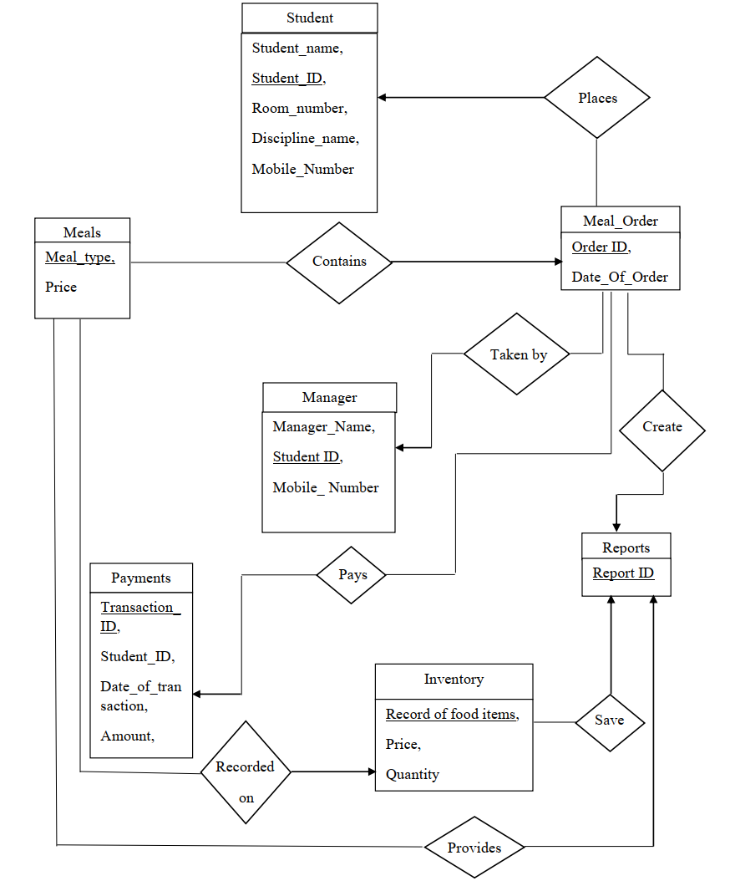
E-R Diagram

Slide 7
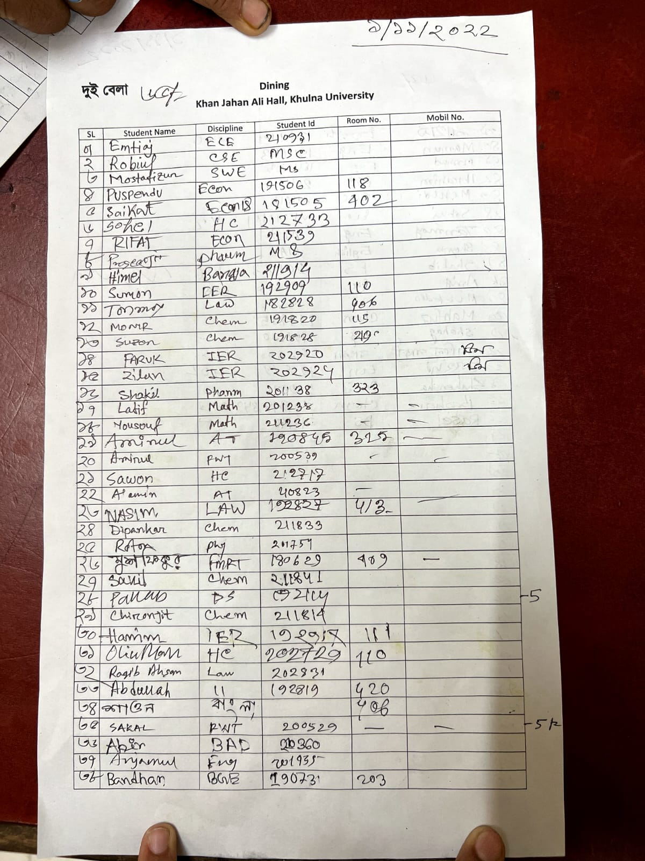
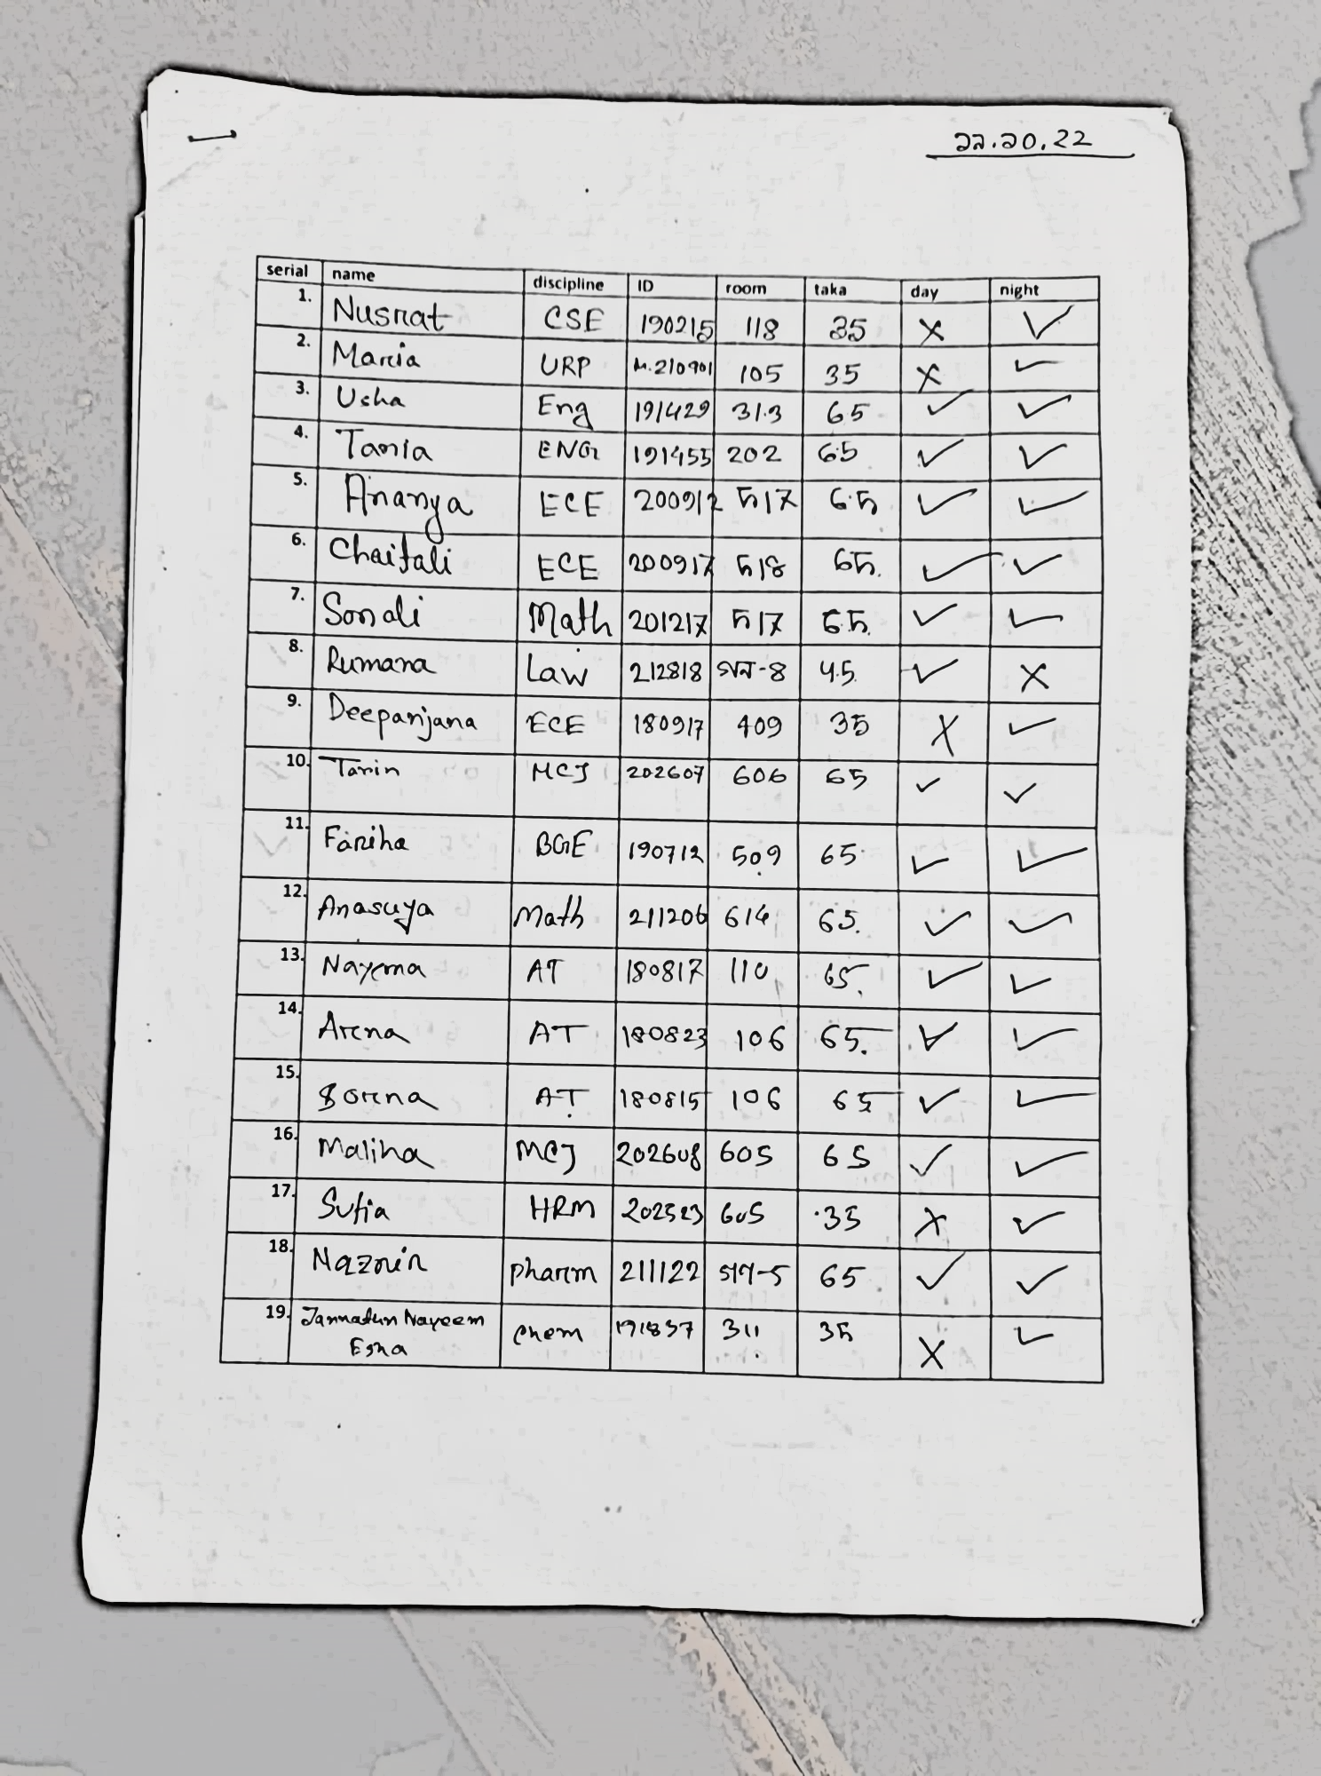
Related Documents

Slide 8
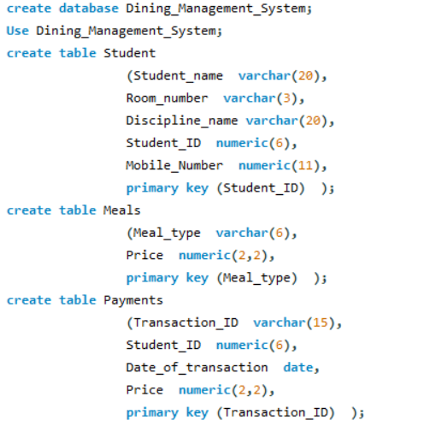
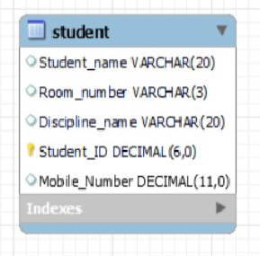
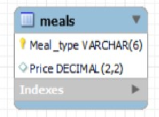

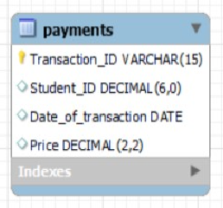
SQL Command

Slide 9
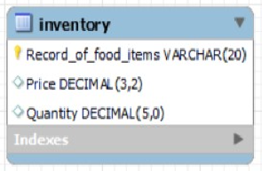
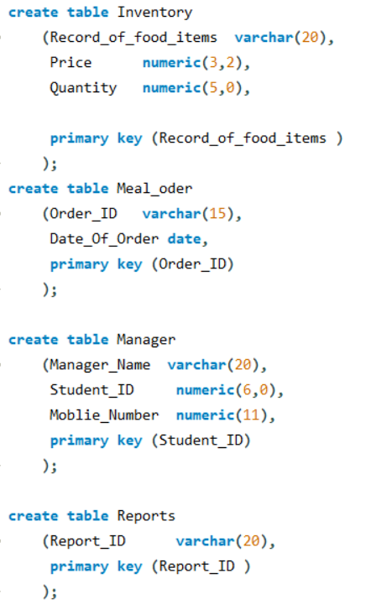
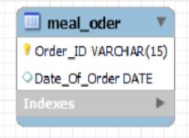
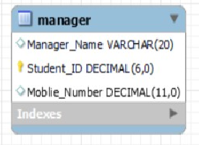
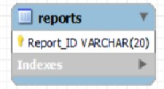
SQL Command

Slide 10
Tools and Technologies
Operating system : Windows 11 Home
Framework : .NET
Front end design : HTML, CSS
Back end design : PHP
Workbench : MySQL
Programming language : JAVA
Connectors : jdbc

Slide 11
Thanks!
Istyaque Ahammed(200240)
Sumaiah Binta Musa(190205)
Samundra Dhakal(200245)

